Slide 1


TITLE OF THE PROJECT
SUSTAINABLE ENERGY EXCHANGE BETWEEN HOUSEHOLDS USING SOLAR POWER INTEGRATION
BEEE304L- POWER SYSTEMS ENGINEERING

Slide 2

TEAM MEMBERS
RITVIK ANISH - 23BEE1018
SANJH YADAV - 23BEE1043

Slide 3
PROBLEM STATEMENT
With increasing residential electricity demand and growing adoption of distributed renewable energy sources such as solar photovoltaics, there exists an opportunity to enhance energy efficiency and grid reliability through localized peer-to-peer power sharing. Traditional power supply frameworks treat households as independent consumers reliant solely on the central electricity board (EB), which can lead to inefficiencies during peak load periods. Furthermore, surplus solar energy generated by one household often remains underutilized or fed back to the grid with limited benefits. This project addresses the challenge of enabling direct power trading between neighboring houses—House A with solar generation and House B without—to optimize energy usage, reduce dependence on the central grid, and provide economic and sustainability benefits.

Slide 4
COMPONENTS REQUIRED
  9V LiPO Battery (For EB)
  Contractor - DPDT/ 2-pole changeover (2)
  Relay + Buck Converter (Acts as Circuit Breaker)
  Cables, Sockets, Plugs
  ESP32 Microcontroller (Wifi Module for IoT)
  Current Sensor (INA219)
  Voltage sensor
  LED for request indication
  Solar Panel/ Solar cell - 5V
  Panel Box, Enclosures

Slide 5
INTRODUCTION
The rising global electricity demand and the need to cut greenhouse gas emissions have accelerated the shift toward renewable energy integration. Solar photovoltaic (PV) technology stands out for its scalability, low environmental impact, and suitability for distributed generation.
In the conventional setup, households depend entirely on the electricity board (EB), leading to inefficiencies during peak demand, while surplus solar energy in some homes often goes unused. This project proposes a peer-to-peer (P2P) power-sharing system between two houses—House A, with solar PV generation, and House B, reliant solely on EB supply. When House B’s demand exceeds EB capacity, it procures surplus power from House A.
This arrangement simulates a localized microgrid, aiming to improve energy utilization, reduce grid dependency, and demonstrate the technical and economic viability of small-scale decentralized power trading.

Slide 6
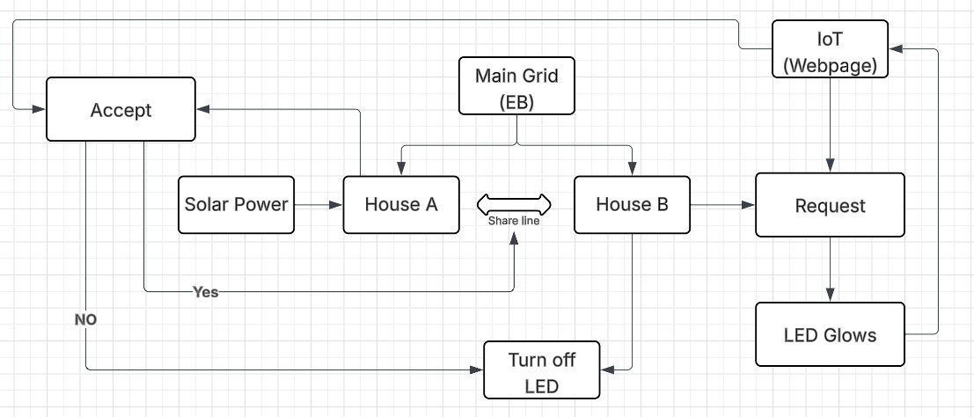
BLOCK DIAGRAM

Slide 7
PPROPOSED WORK
(PRACTICAL IMPEMENTATION PLAN)
  WORKING SCALED-DOWN HARDWARE PROTOTYPE WITH FUNCTIONAL P2P SHARING.
  CIRCUIT DIAGRAM AND WIRING LAYOUT.
  EMBEDDED CONTROL PROGRAM WITH DOCUMENTED CODE.
  DATA LOGS SHOWING REAL-TIME ENERGY SHARING BEHAVIOR.

Slide 8
DETAILED PLAN OF ACTION
The work will be executed in three main stages:
1. System Planning & Component Selection
  Identify and procure appropriate components for a small-scale demonstration:
    Miniature solar PV panel(s) for House A’s renewable source.
    DC supply module or low-voltage AC source for simulating EB power.
    Loads for both houses (e.g., resistive lamps, small appliances, or equivalent resistive modules).
    Energy meters or wattmeters to measure consumption and transfer.
    Microcontroller (Arduino / Raspberry Pi / PIC) for control logic implementation.
    Relays or solid-state switches for power routing.
    Current and voltage sensors for monitoring conditions.
  Prepare wiring diagrams showing all connections between EB supply, PV supply, and both houses.

Slide 9
DETAILED PLAN OF ACTION
2. Hardware Construction & Control Logic
  Assemble two independent load circuits to represent Houses A and B.
  Integrate the solar PV panel into House A’s supply side.
  Connect EB supply to both houses through appropriate control relays.
  Install metering at:
    EB supply to House A and House B.
    Solar PV power output from House A.
    Power transferred between House A and House B.
  Develop microcontroller code to:
    Monitor House B’s load demand.
Detect House A’s available surplus from the solar panel

Slide 10
DETAILED PLAN OF ACTION
3. Testing & Demonstration
  Test under different load conditions:
    Low load (no transfer required).
    High load on House B with available surplus from House A (transfer occurs).
    High load on House B without surplus from House A (fallback to EB only).
  Record the data for:
    Energy supplied by EB.
    Energy supplied from House A to House B.
    Reduction in EB usage for House B during sharing periods.
Document the operational sequence and demonstrate live to show automatic decision-making and sharing

Slide 11
OBJECTIVES
  To design a peer-to-peer (P2P) power-sharing system that enables House B to buy surplus solar energy from House A during high-demand periods.
  To develop a control strategy that manages power flow between House A, House B, and the EB, ensuring stable and secure operations.
  To simulate and analyze the performance, reliability, and economic impacts of the proposed system under varying consumption and generation scenarios.
  To propose metering and billing mechanisms for fair accounting of energy exchanges between the houses.
  To evaluate the potential reduction in carbon footprint and grid dependency achieved through this localized energy sharing approach.

Slide 12
FUTURE SCOPE
  The project focuses on a simplified microgrid model with two residential units connected to a centralized supply—EB.
  Analysis will include house load profiles, solar generation patterns, power flow control, and system coordination.
  Billing and settlement mechanisms for power transactions between households will be conceptualized but not implemented physically.
  Grid interaction assumes a single point of connection with typical residential voltage levels and supply constraints.
  The environmental impact evaluation will be limited to estimated energy savings and associated reductions in greenhouse gas emissions.

Slide 13
Thank you.

